Slide 1
RETAIL SHOPPING INSIGHTS
From raw retail data to business decisions with Python, SQL & Power BI
Sikhululiwe Masuku
Aspiring Data Analyst | Data Analysis Portfolio Project

Slide 2
Project Overview
Explores customer shopping behaviour in a retail store to uncover purchasing patterns, gauge sales performance and understand what drives customer spending.
3,900
18
37
Rows (customer records)
Columns
Missing values (Review Rating)
PYTHON
Clean & engineer features
MYSQL
Answer 10 business questions
POWER BI
Interactive KPI dashboard

Slide 3
Data Preparation in Python
Missing values
Column standardisation
Age groups
Filled 37 null Review Ratings with the median of each product category
Renamed columns to lowercase snake_case for readability
Binned age into Young Adult, Adult, Middle-aged and Senior using quartiles
Purchase frequency
Consistency check
Export
Mapped frequency labels (Weekly, Monthly...) to days
Found discount_applied and promo_code_used identical, so dropped the redundant column
Saved the cleaned dataset to CSV and loaded it into MySQL

Slide 4
SQL Insights: Who Drives Revenue?
Male customers generated about 68% of revenue. Spend is spread fairly evenly across age groups, however Young Adults are the highest spenders.

Slide 5
SQL Insights: Discounts, Shipping & Newsletter
$60.48 vs $58.46
Avg purchase: Express vs Standard shipping
$59.49 vs $59.87
Avg spend: Subscribers vs Non-subscribers
Roughly half of sales for these five items use a discount. Subscribers spend about the same as non-subscribers, yet only 27% of customers subscribe.

Slide 6
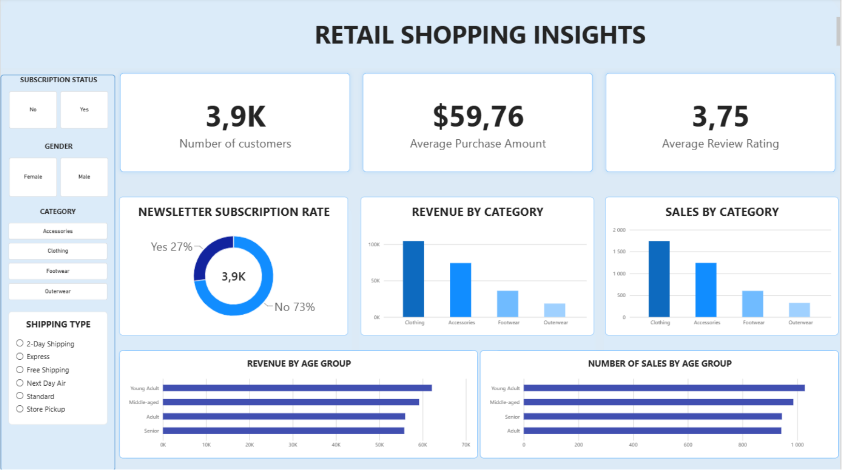
Power BI Dashboard
KPIs, category revenue and sales, subscription rate and age-group trends, filterable by subscription, gender, category and shipping type.

Slide 7
Business Recommendations
Review marketing by gender Male customers brought in $157,890 vs $75,191 from female customers. Investigate customer counts and purchase patterns to find growth in both segments.
1
Evaluate discount strategy Hats, sneakers, coats, sweaters and pants are discounted on about 47-50% of sales. Check profitability and whether discounts are needed this often.
2
Grow newsletter subscriptions Only 27% subscribe and spend is similar. Test targeted incentives to build the base.
3
Review express shipping Express orders average slightly more ($60.48 vs $58.46). Weigh the lift against fulfilment cost.
4
Strengthen retention Use purchase history to target Returning and Loyal customers with personalised offers and loyalty rewards.
5

Slide 8
Skills Demonstrated
Python
Pandas, cleaning, feature engineering
SQL (MySQL)
Aggregations, CTEs, window functions, CASE
Power BI
KPIs, interactive dashboards
Business insight
Turning data into recommendations
Sikhululiwe Masuku
Aspiring Data Analyst | Open to internship opportunities
Dataset and tutorial by Amlan Mohanty (GitHub, YouTube); cleaning, SQL, dashboard and report are my own implementation.

